Slide 1
Team 9
Max(Qi Kai), Jimmy, Soham

Slide 2
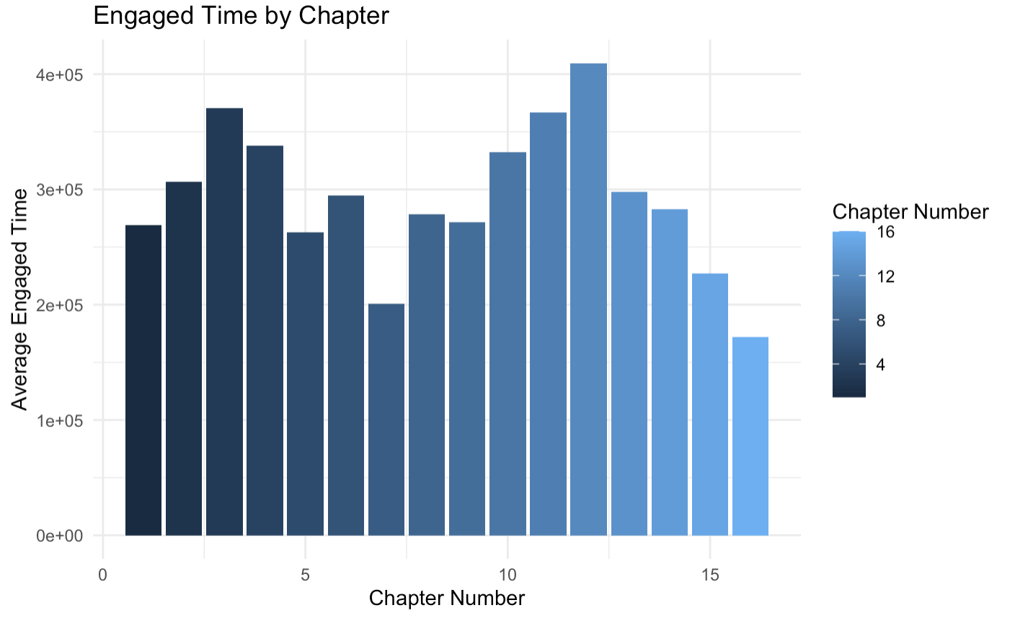
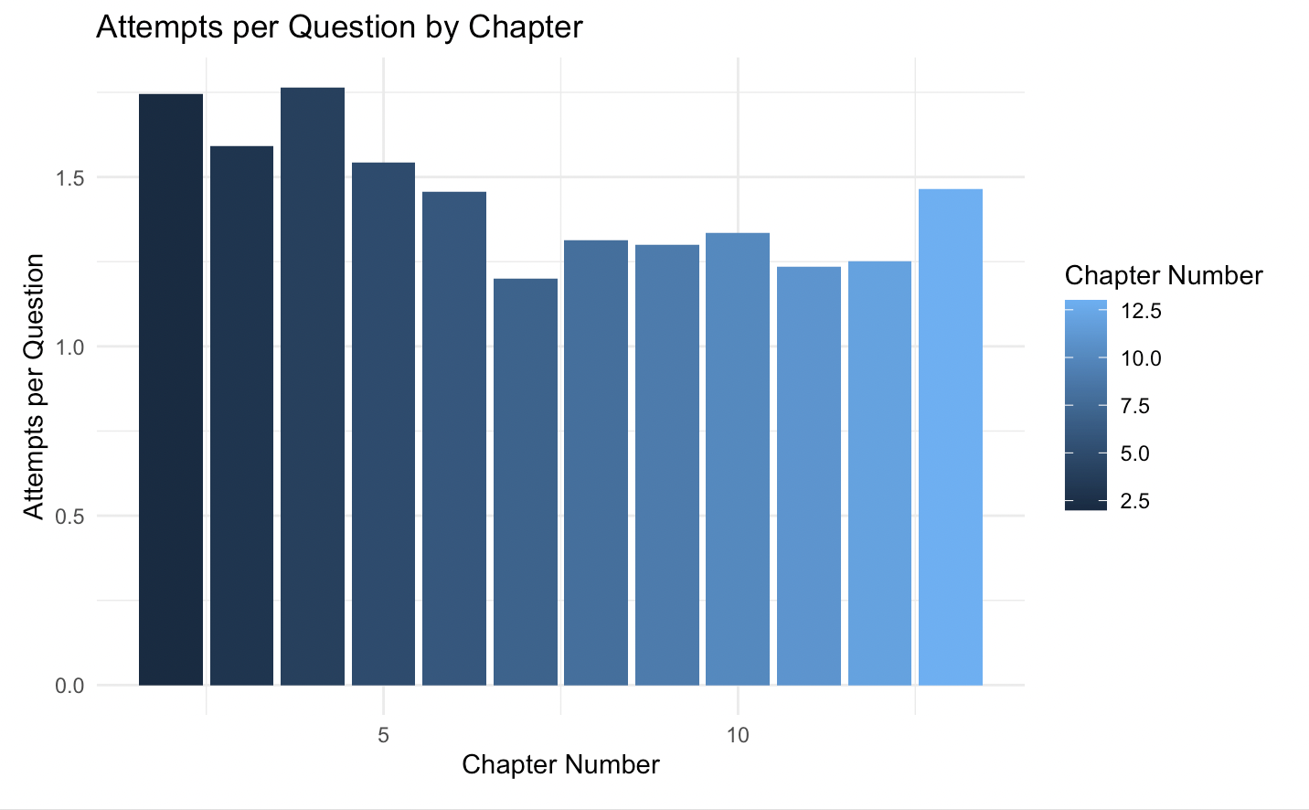
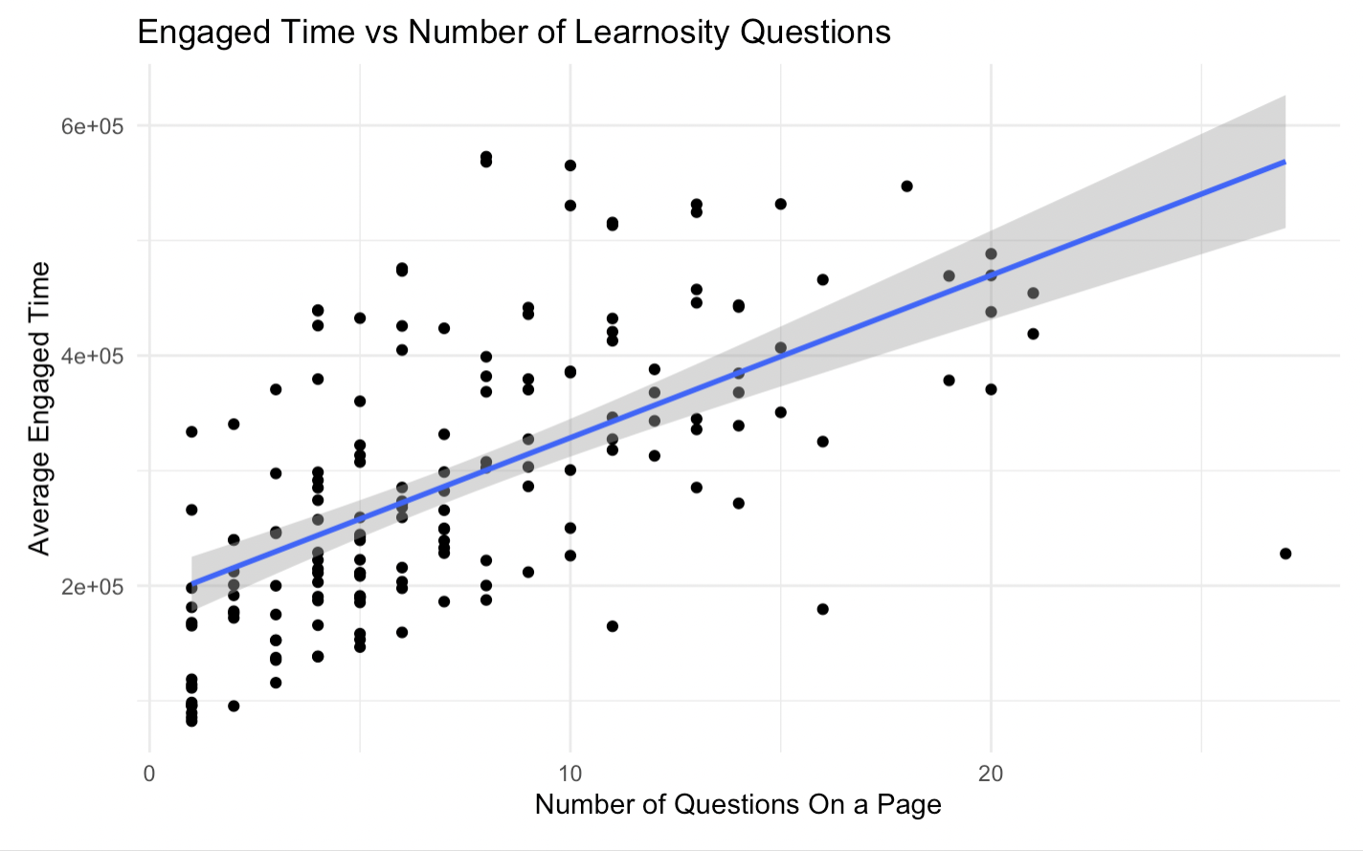
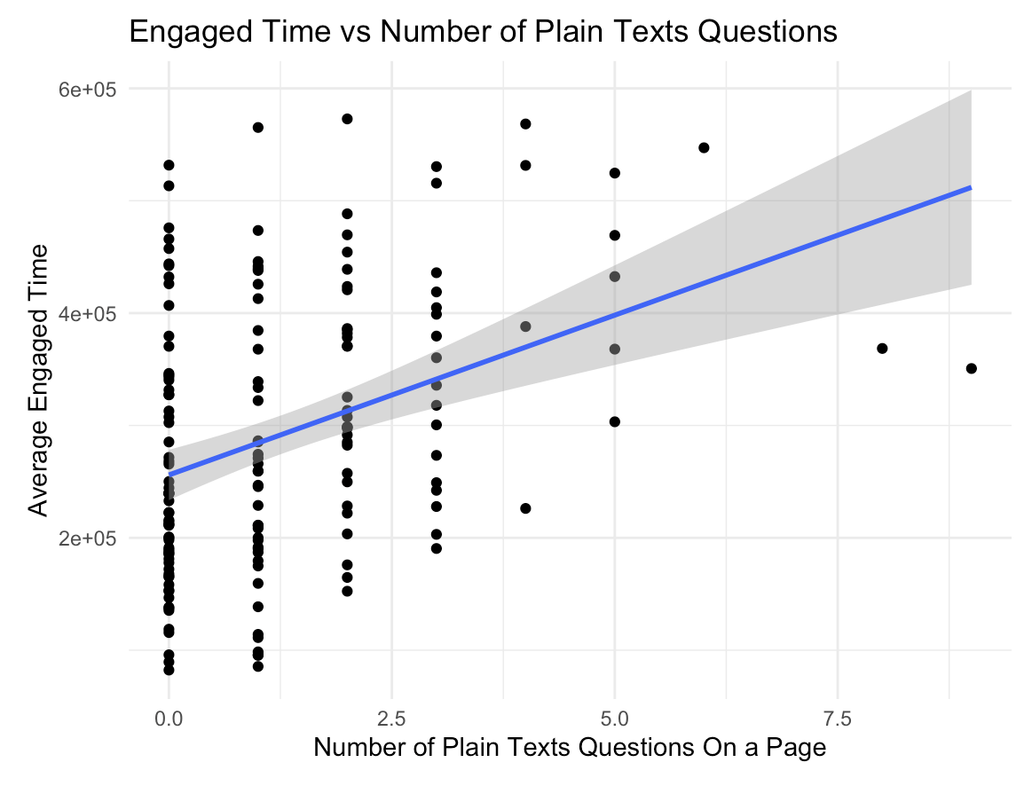
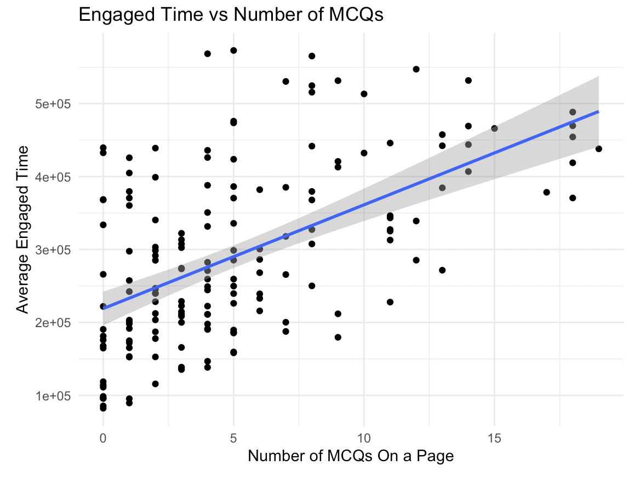
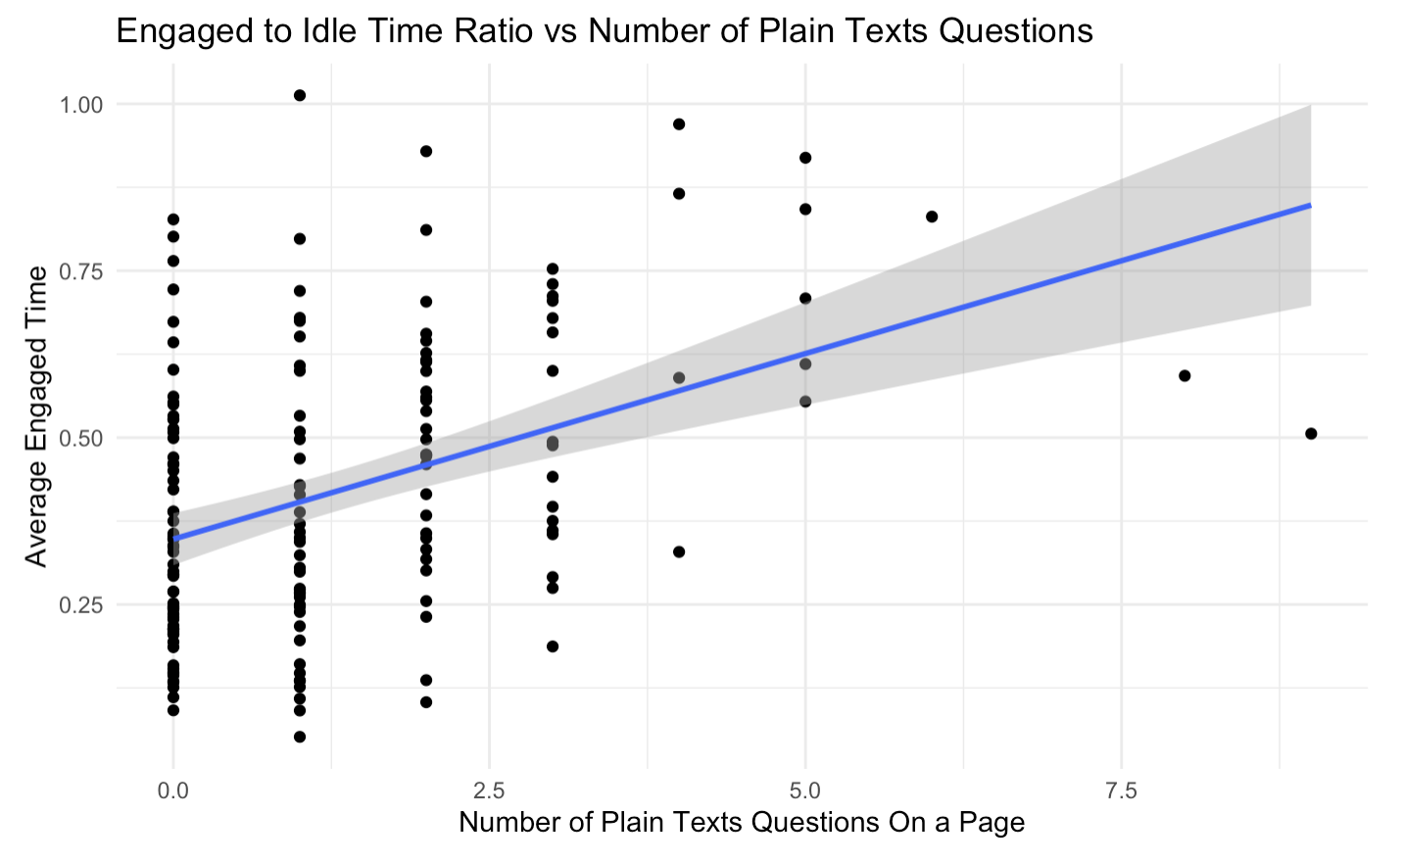
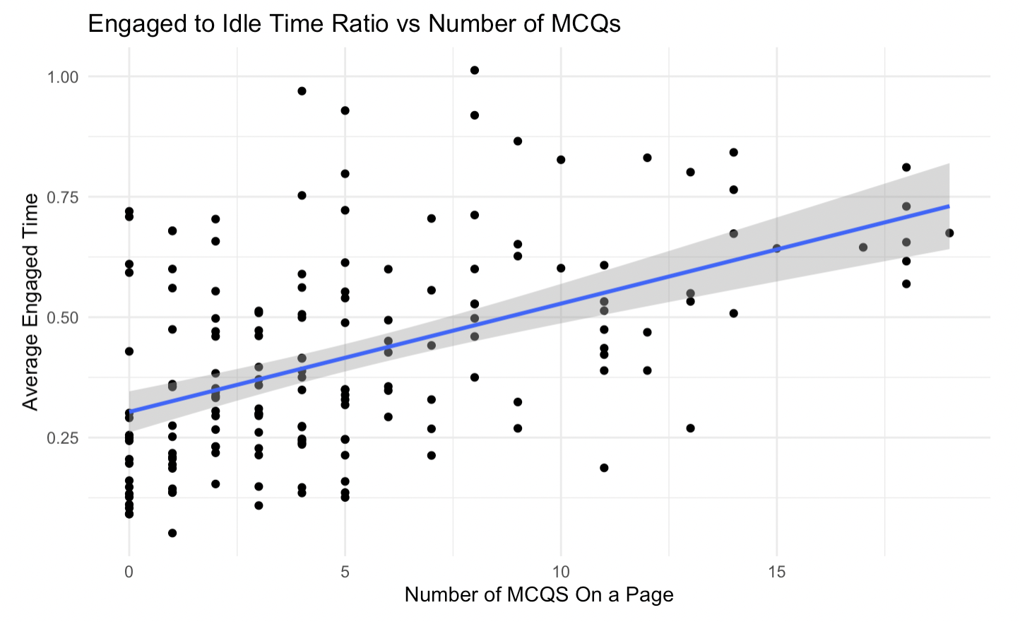
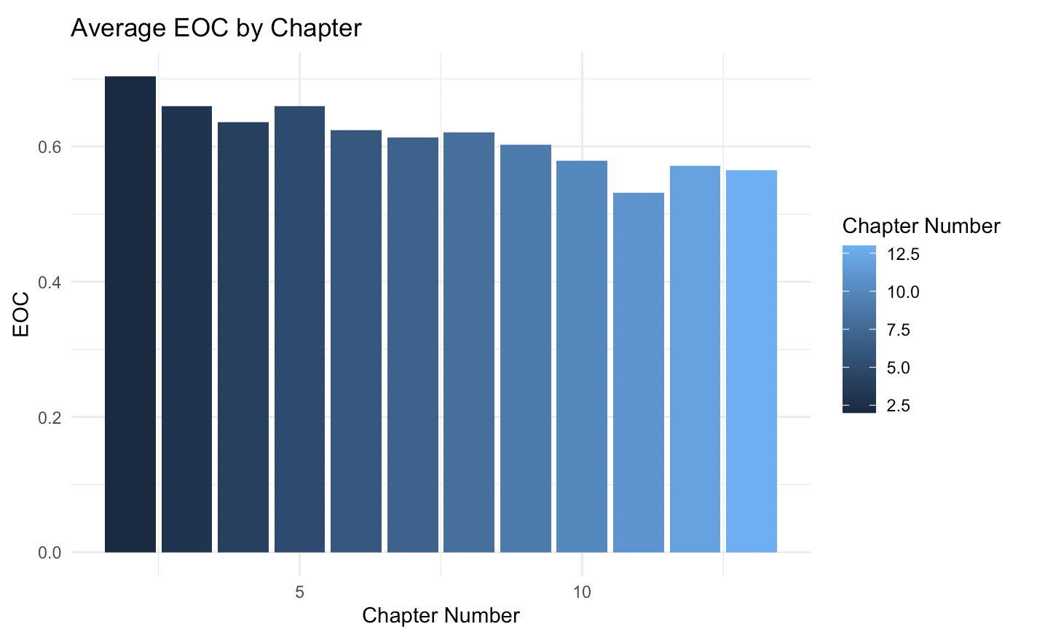
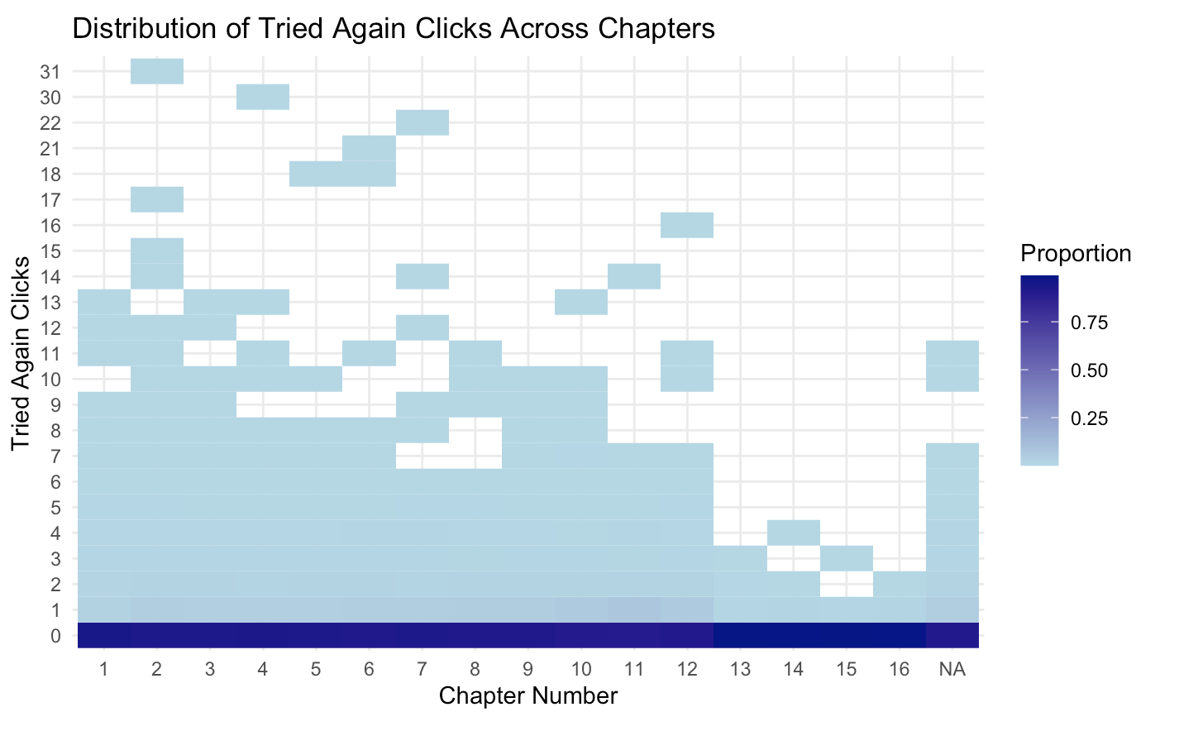
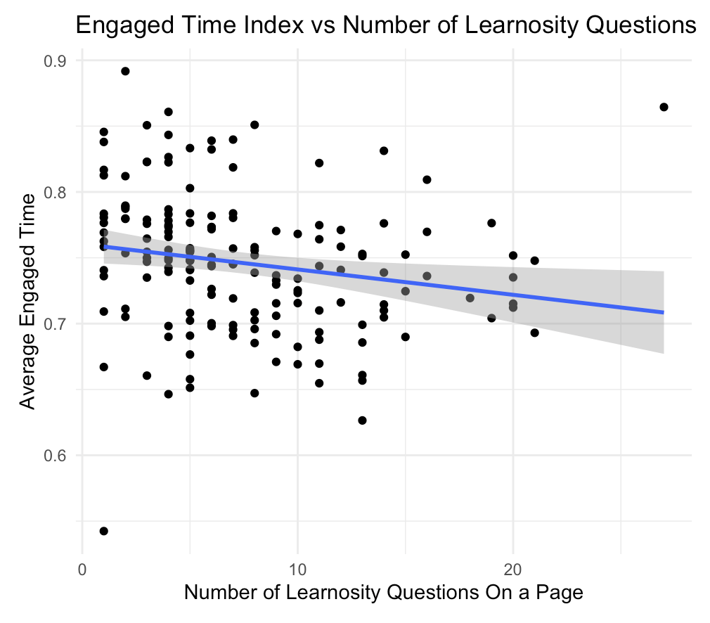
Engagement
Time engaged, efforts and performance generally decrease with chapters
Number of Learnosity questions positively correlates with engagement, especially plaintext and MCQ.
Recommendation:
Implement more plaintext and mcq questions for less engaged page
For longer term, explore effects of different question types to determine the best type that can increase engagement, engagement to idle ratio and engagement index
*Note on engagement index (engaged time /total time on page):
More questions makes student stay engaged longer, but also increase the total unengaged time. Too many questions may overwhelm students.

Slide 3
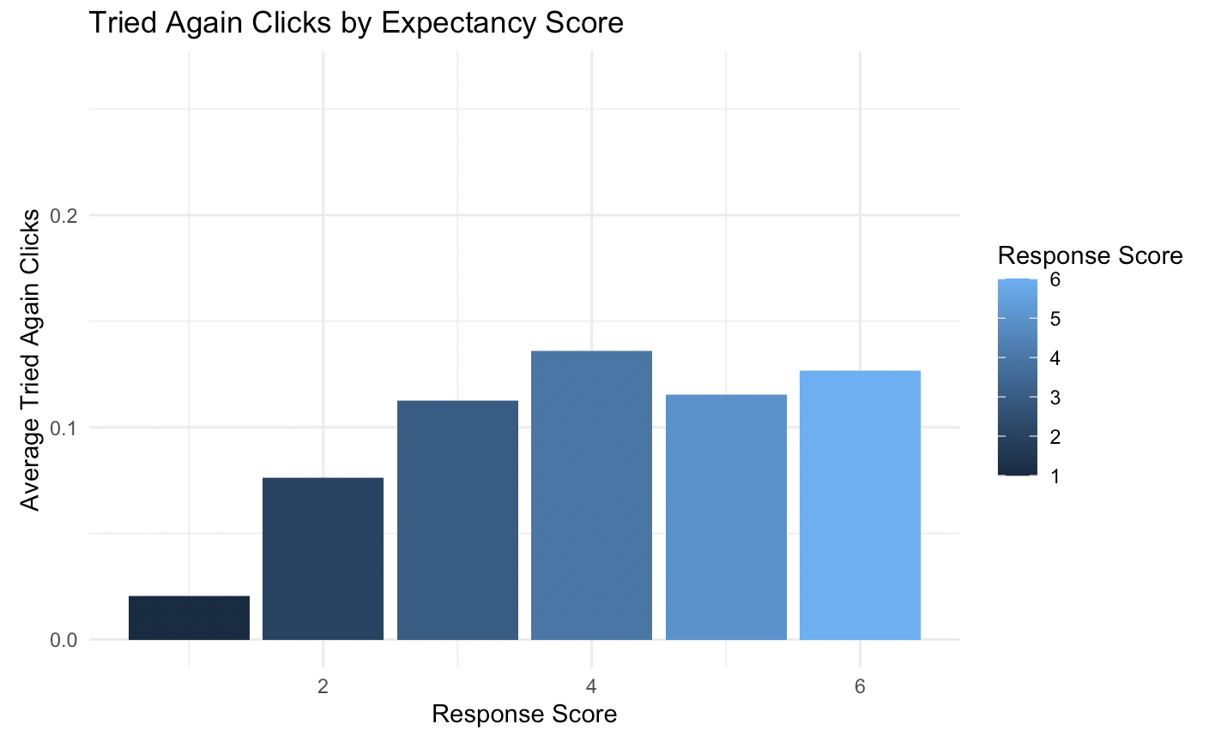
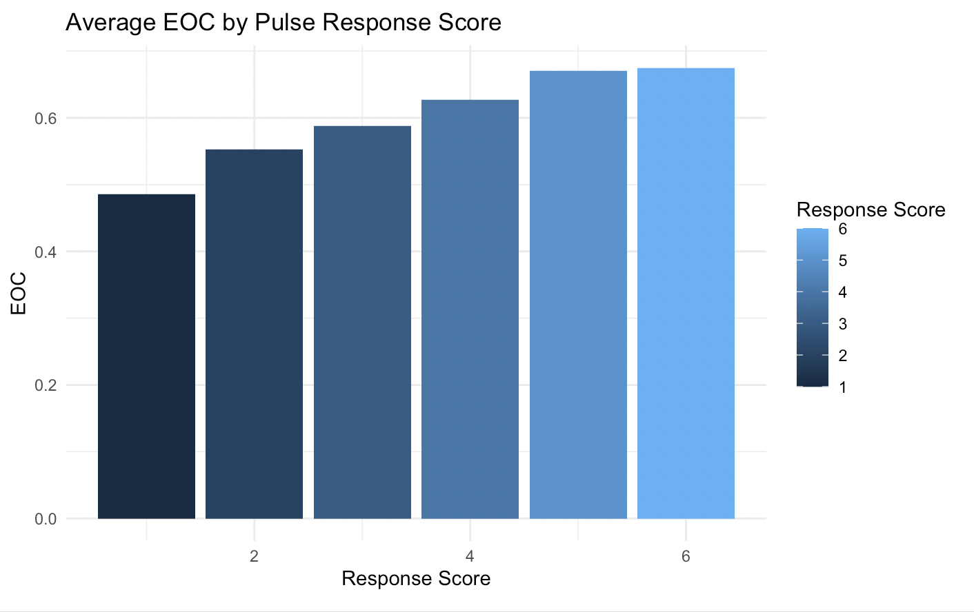
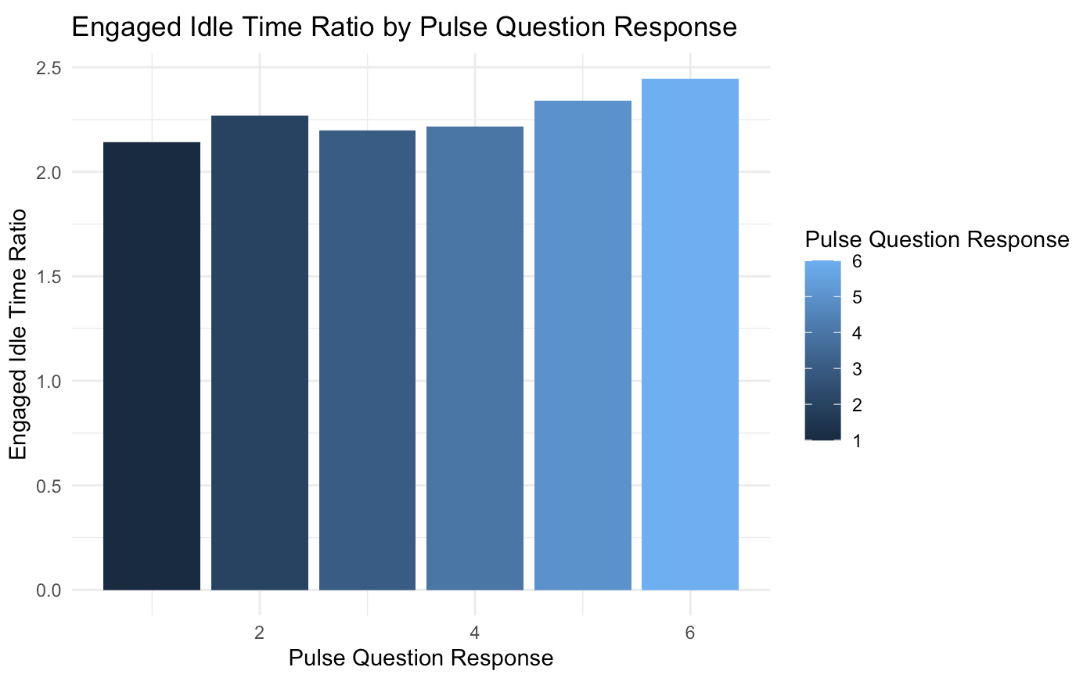
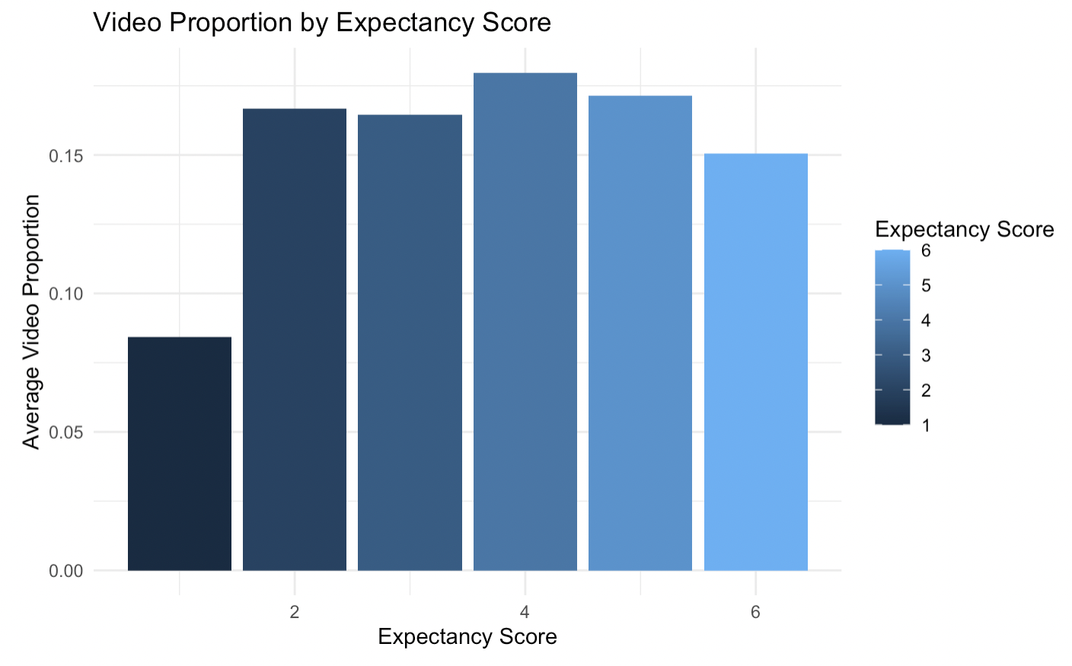
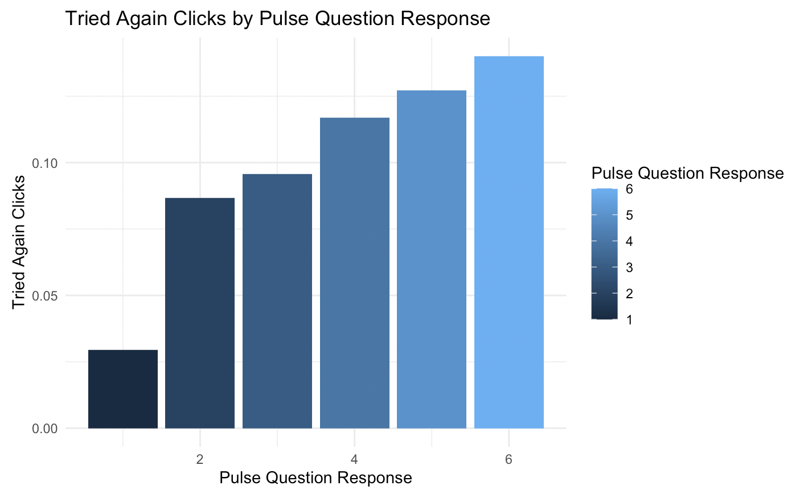
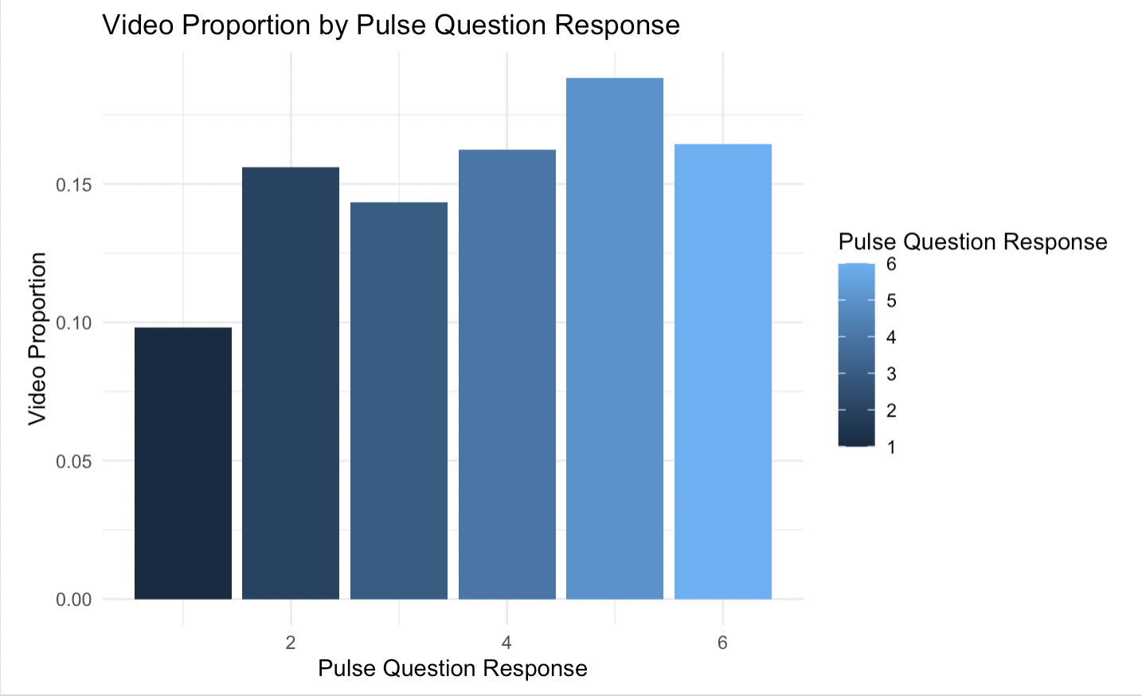
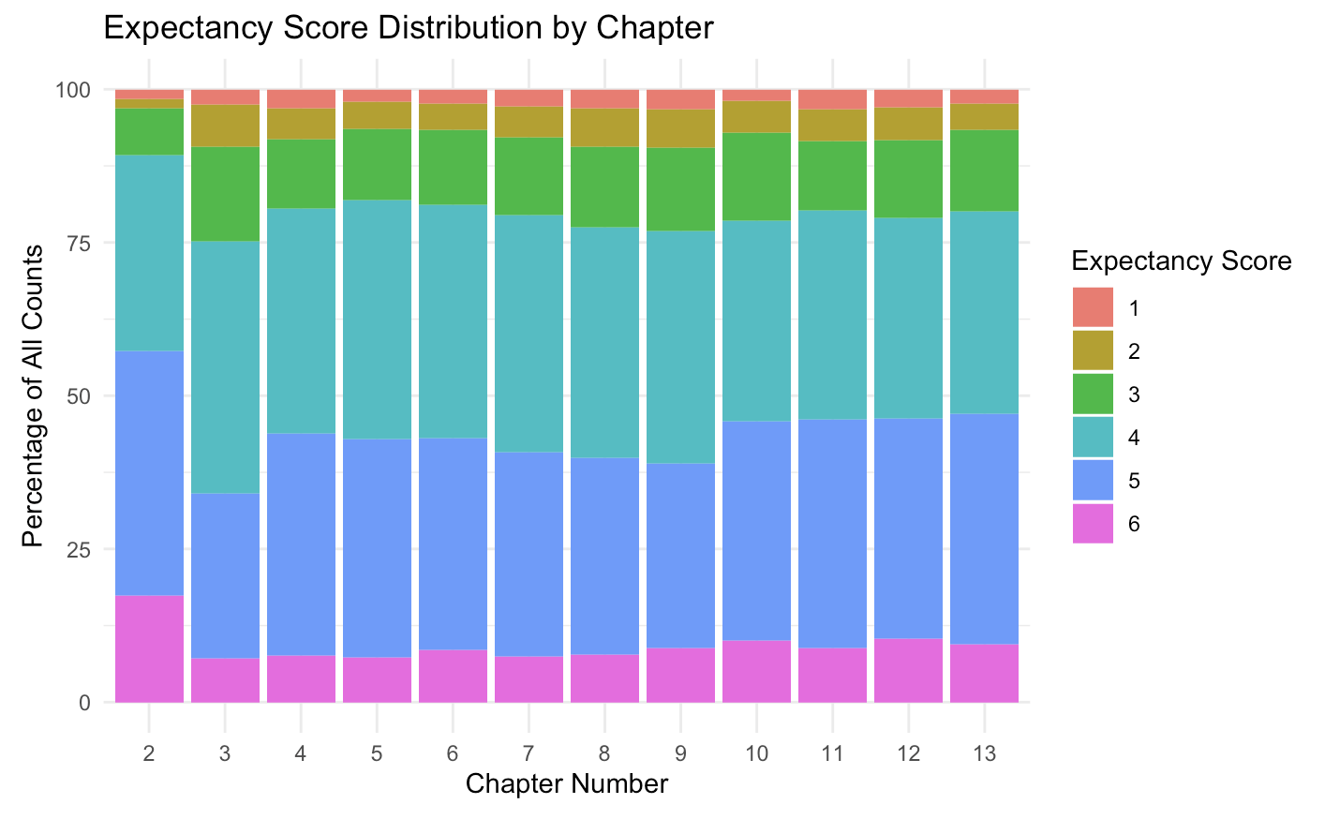
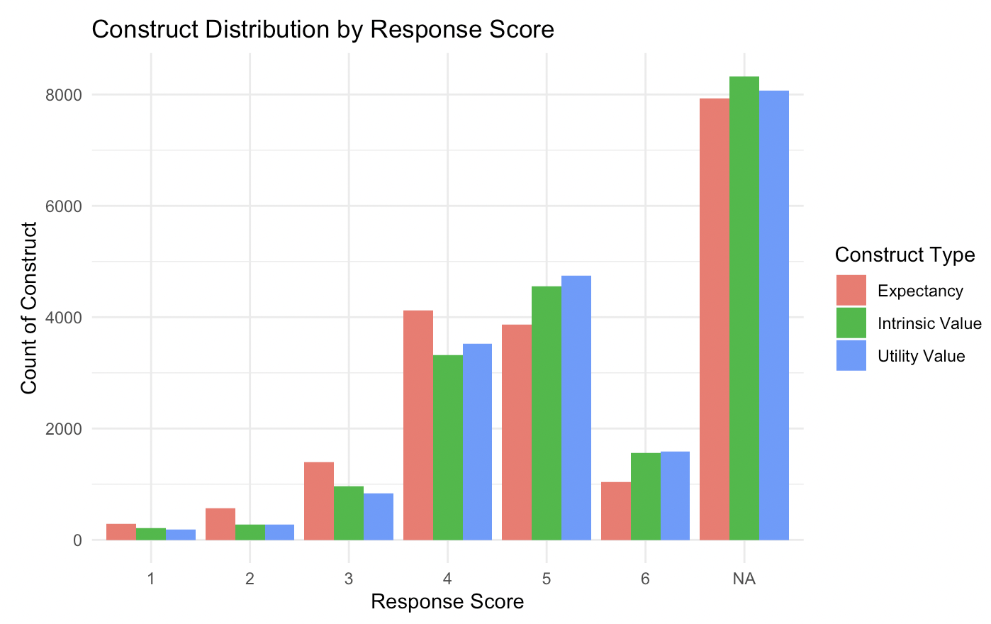
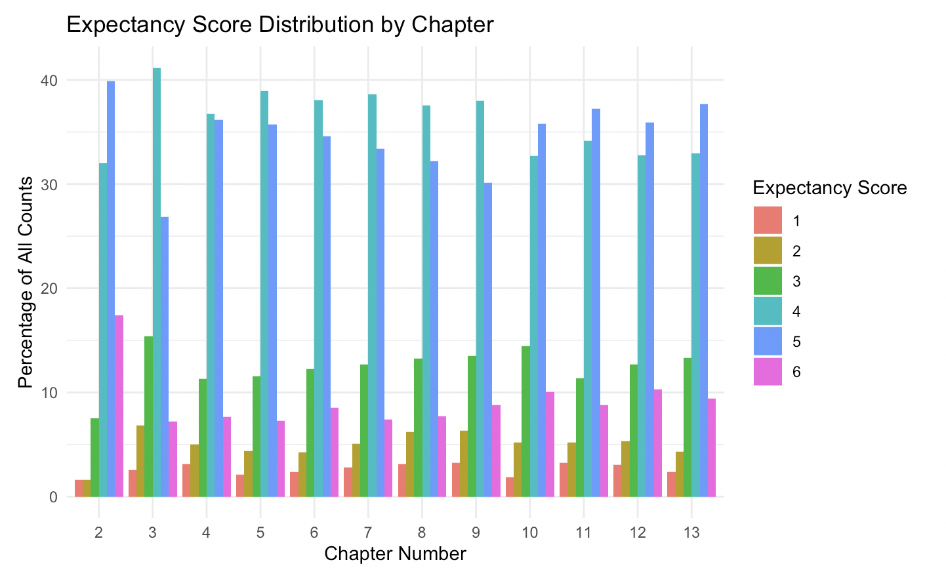
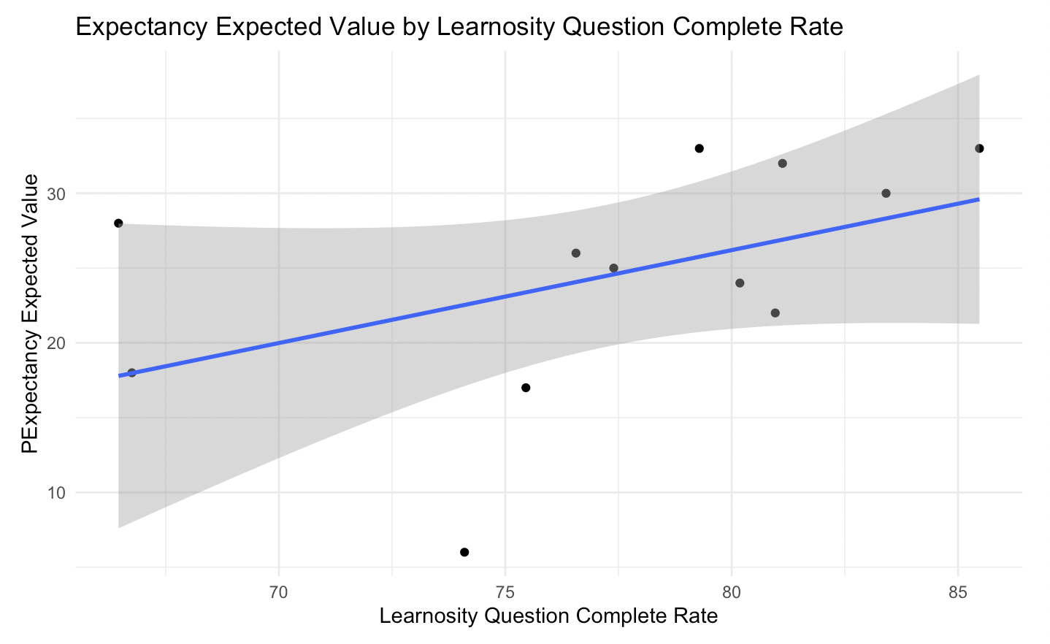
Response to Construct/Pulse Questions
Recommendation:
Tailor content more to utility value, as Utility most in high response scores
Encourage trying again as tried_again_clicks correlate with high expectancy
Encourage watching more video, as students scored 1 watches least video
Investigate further in why Chapter 2 has the most high scores, and why Chapter 3,4,7,8,9 have less high expectancy score
Encourage higher completion of learnosity questions, higher complete rate (lrn_status %of completed) correlate to higher expected value of expectancy score
Higher score (excluding Cost), correlates to higher EOC, engaged to idle time ratio, tried again clicks and video proportion. Meaning better effort, focus and learning.
Expectancy construct occurs most in low response score

Slide 4
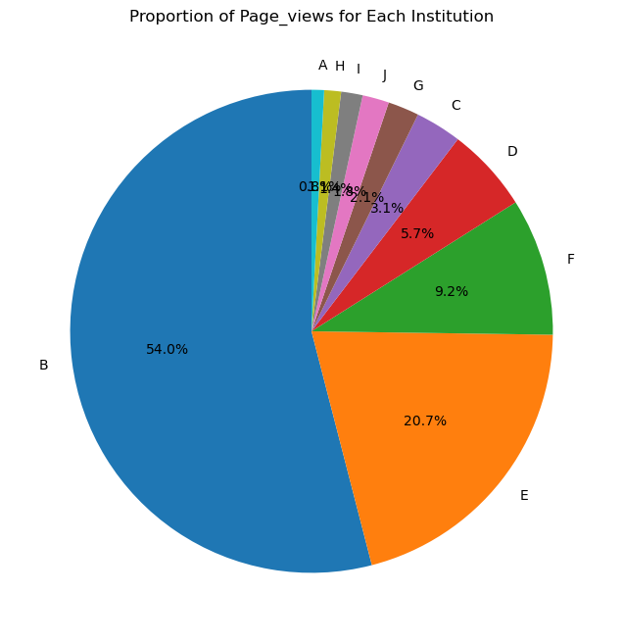
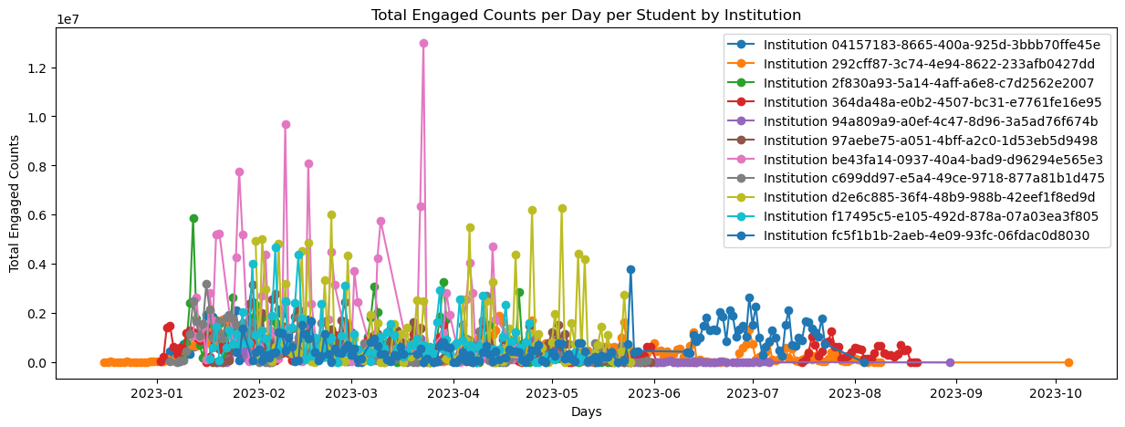
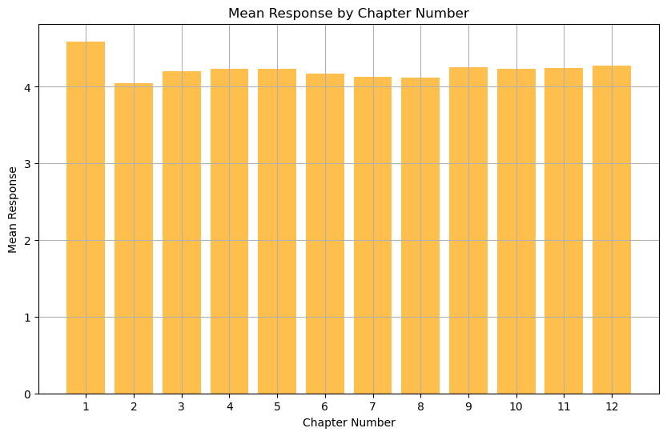
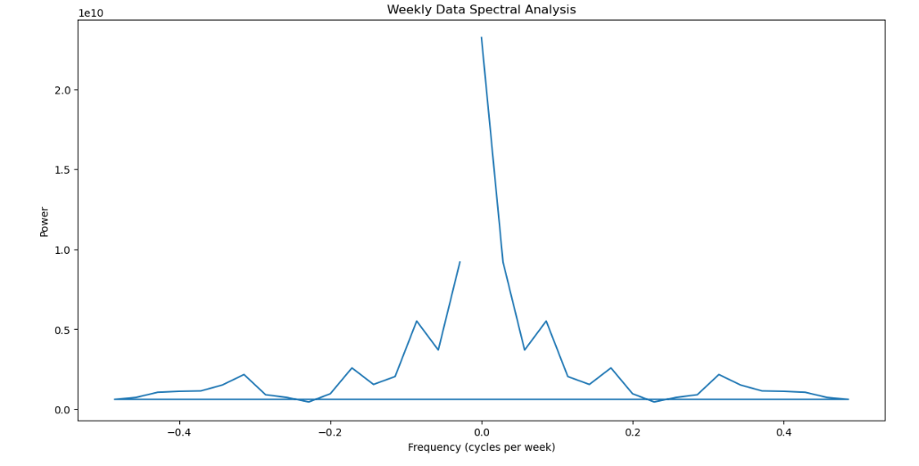
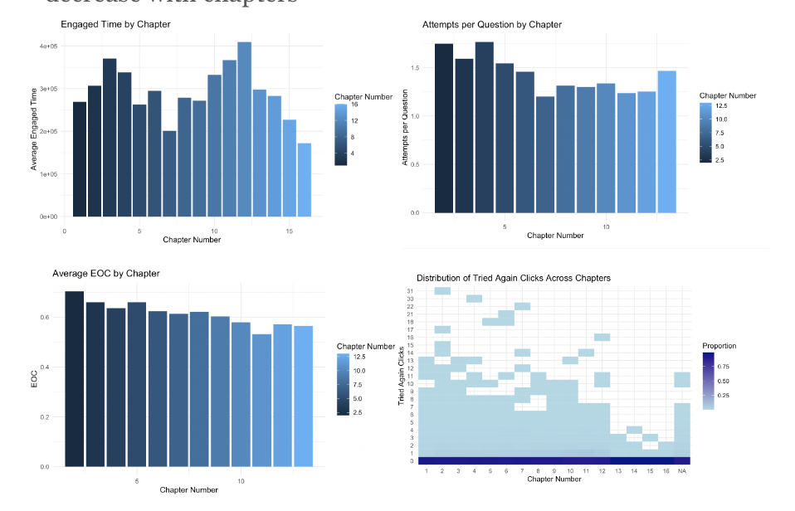
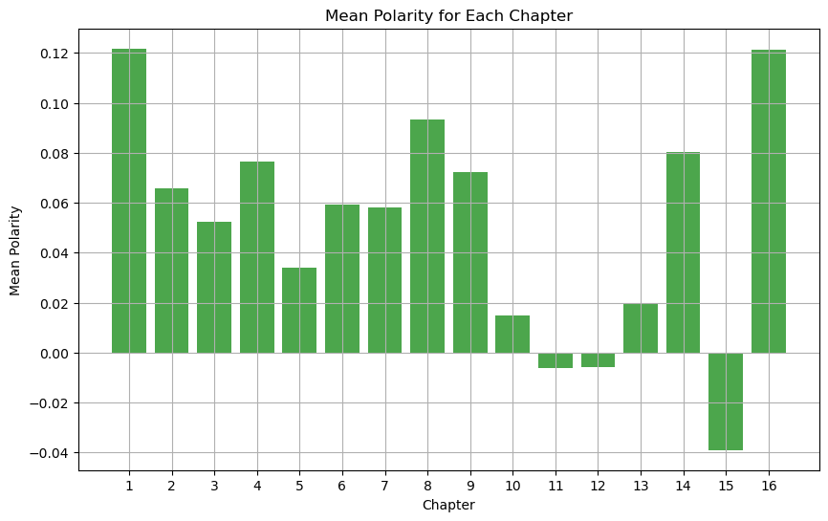
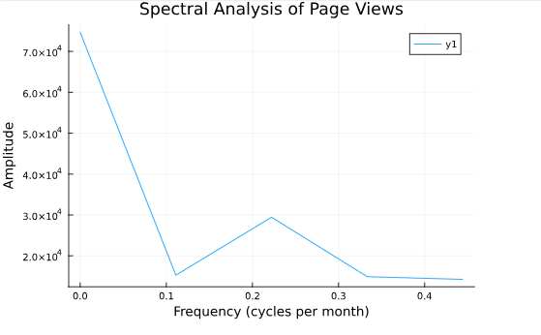
5 = Strongly Agree: I am confident about what I learned.
Student’s confidence in their learning remains stable by chapter
But from before…
One institution make up 54% of page views and similar proportion in the other data sets
and
(sentiment) of the plaintext responses
-1 indicates a highly negative sentiment.
0 indicates a neutral sentiment.
1 indicates a highly positive sentiment.

